Slide 1
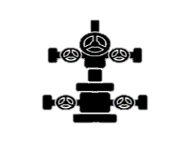
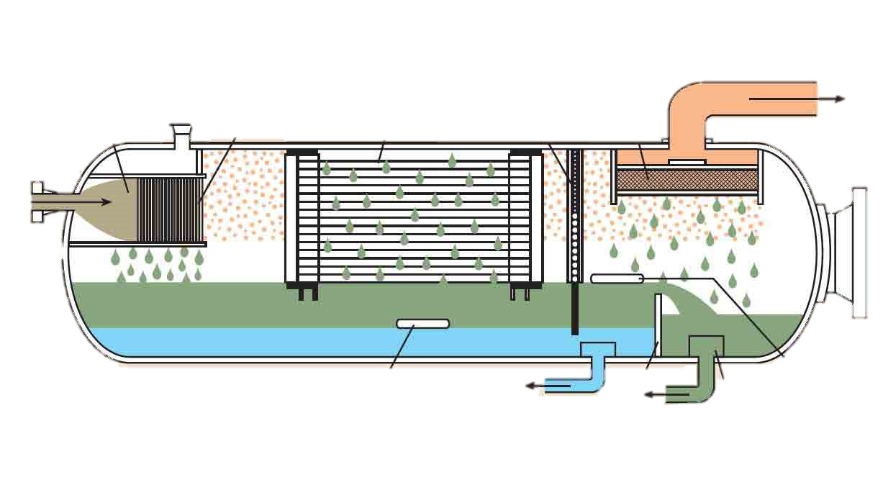
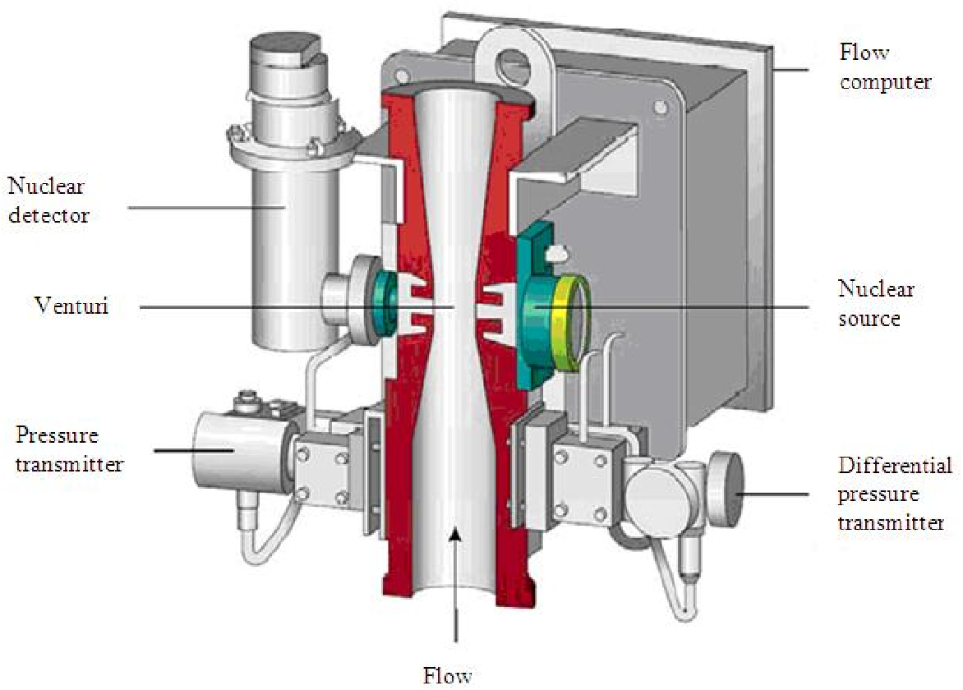
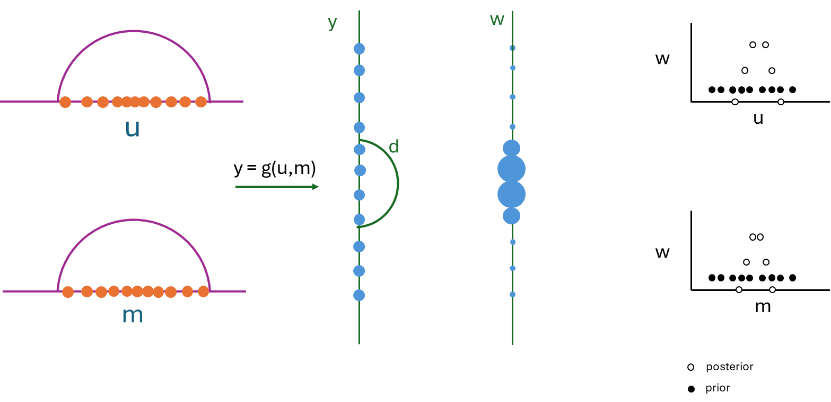
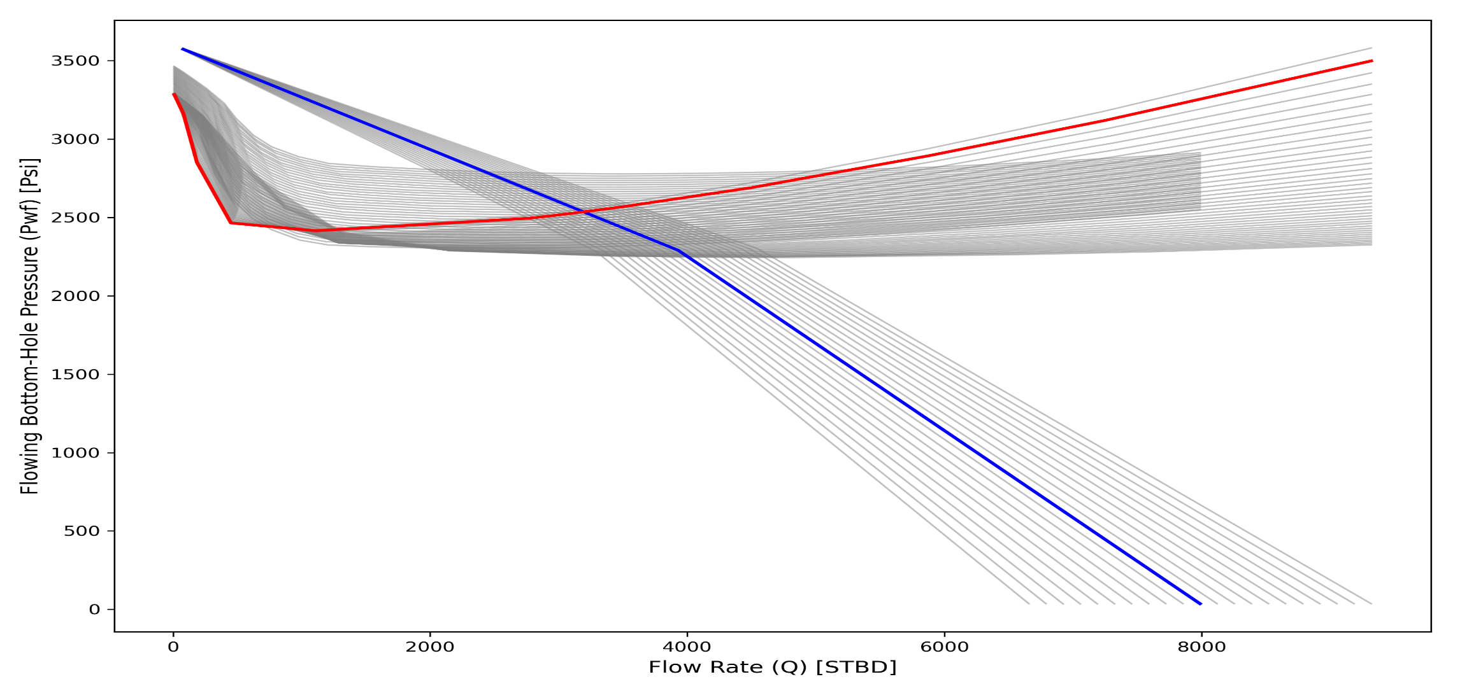
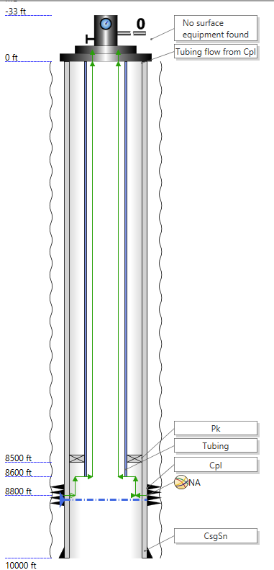
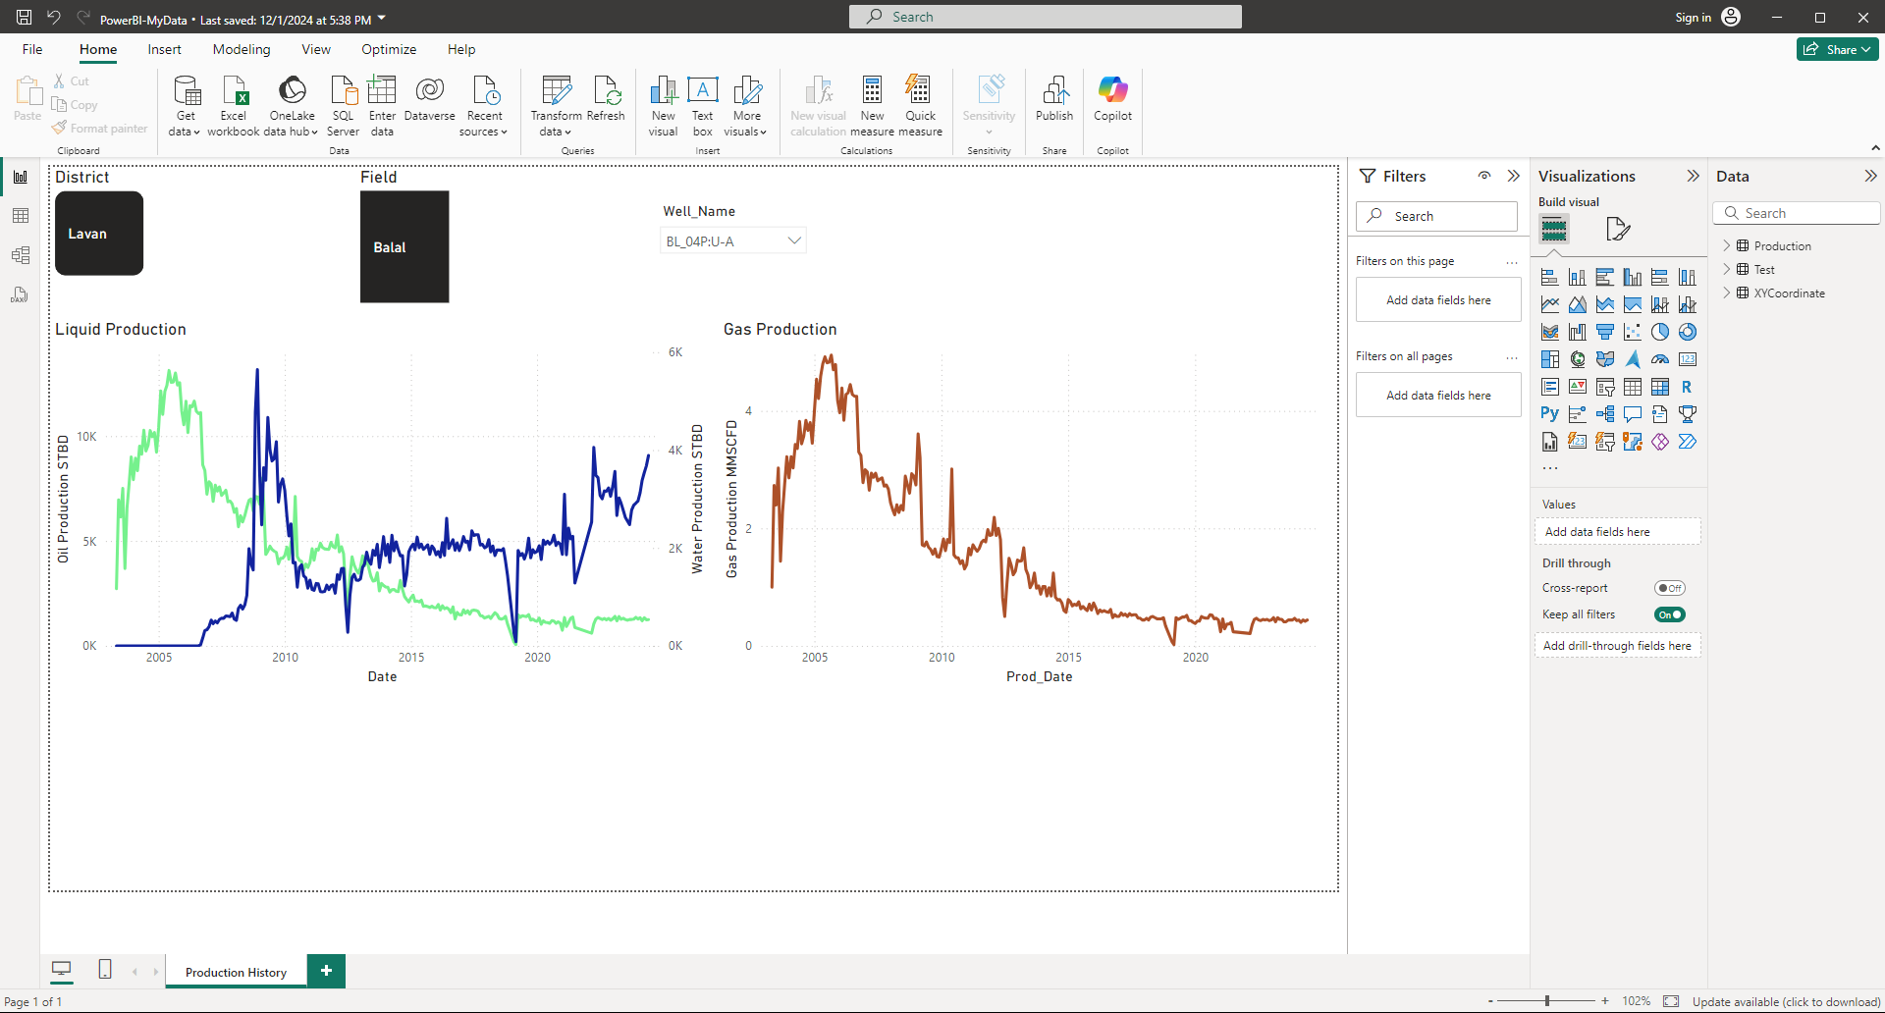
دانشکده مهندسی شیمی و نفت
دانشگاه صنعتی شریف
هفته پژوهش سال 1403
Incorporating Data Assimilation Techniques to Improve the Accuracy and Reliability of Virtual Flow Meters
Arash Rabiei
Supervisors: Shahab Ayatollahi, Ramin Bozorgmehry Boozarjomehry
Department of Chemical and Petroleum Engineering, Sharif University of Technology, Tehran, Iran
Introduction
Data Assimilation
Accurate measurement of produced volumes of oil, water, and gas is important in several ways in the oil and gas industry. First and foremost, it defines the economic value of the extracted resources, thus directly touching on revenue calculations and financial planning. Precise flow measurements enable operators to optimize production strategies by understanding reservoir performance and making informed decisions on well interventions and enhanced recovery techniques. Multiphase flow metering resolves the problems of measuring mixed-phase flow without requiring expensive and space-consuming separation equipment. Traditional techniques involving test separators are costly and involve difficulties concerning maintenance and operation efficiency. MPFMs measure in real-time and continuously measure the oil, water, and gas flow rates directly in the pipeline, enhancing well performance monitoring and reducing the time taken to identify anomalies [1-2].
Virtual Flow Metering (VFM):
Estimating oil, gas and water flowrates produced from wells without measuring them directly and by using available field data. Virtual flow metering applies mathematical models to existing sensor data to provide an estimate of flow rates, further reducing the dependence on physical hardware. Implementation of VFM can significantly reduce CAPEX by avoiding several pieces of physical meters and related infrastructure. OPEX is also reduced due to the lower maintenance burden and mitigation of downtime risks. VFM enables real-time optimization with true, consistent flow estimates that interface directly to control systems for better productivity, proactive maintenance strategies, and overall safety and reliability [4-5].
Based on the modeling paradigm, there are two main approaches in virtual flowmeters:
First Principles virtual flow metering
Data-Driven virtual flow metering
Virtual flow metering - Hybrid Models
One of the key challenges in virtual flow metering (VFM) is dealing with uncertainty and missing data from sensors. Data assimilation is a good tool to address these challenges. It integrates real-time data with mathematical models to more accurately estimate flow rates in pipelines by continuously updating the model's predictions when it receives new data, even if some data is missing or of uncertain quality.
Thus, such a scheme enhances the reliability of the VFMs for taking care of measurement error. For example, the Kalman filter would weigh the amounts of available data according to uncertainty, giving less weight to less reliable measurements, thereby not only filling in missing data but also increasing confidence in overall flow measurements. This, in turn, helps the operators make better decisions about production processes, tweak their operations, and save costs otherwise spent in flow measurement inaccuracies [10].
Choke
(Test) Separator
Multi Phase Flow Meter (MPFM) [3]
Where:
u is model input vector (Uncertain inputs with specific probability distribution function - pdf)
m is model input vector (Uncertain model parameters with specific probability distribution function - pdf)
y: The uncertain inputs u and uncertain model parameters m lead to multiple realizations of the modelled output which is called y
d: measured outputs (the mismatch between actual measured values and predicted values is used to update the uncertain model parameters.
w is the weight of a particle
Developing (hybrid) VFM Models by Integrating Data Assimilation Methods
Development of hybrid VFM models is done by combining data assimilation techniques with both first-principle (physics-based) models and data-driven methods. First-principle models simulate fluid flow using fundamental physical laws and equations. While these models are usually robust under known conditions, they often cannot cope with real-world variability that may be complex. On the other hand, data-driven models rely on machine learning and statistical analysis to find patterns in historical data, flexible but not always interpretable, with extrapolation capabilities. It is in the integration of these approaches through data assimilation-a methodical incorporation of real-time measurement data into model predictions-that hybrid VFM models can realize drastic improvements in accuracy and reliability as far as the estimation of multiphase flow rates is concerned [6].
The integration enables hybrid models to fully leverage the strengths of both methodologies: the physical interpretability and consistency of first-principle models, combined with the adaptability and predictive power of data-driven methods. Data assimilation acts as the bridge between the two, updating model parameters and states in a continuous manner based on incoming sensor data, correcting deviations and compensating for uncertainties. All the above synergizes to get the best treatment nonlinearities, including transients arising in a typical multi-phase flow, permitting improved real-time monitoring and control. Realistically speaking, it all sums up on hybrid modeling VFM-based contribution on enhanced production methods at reduced operations costs of productions and serves as a guide toward much superior decisions relating to a reservoir [7].
Data Assimilation in Nodal Analysis
Measurement Points
Nodal Analysis in Production Systems
Nodal analysis is a practical tool that engineers use to evaluate and enhance the performance of production wells in the oil and gas industry. The idea is to divide the entire production system into different sections, or "nodes," such as the reservoir (where the fluids originate) and various points along the wellbore up to the surface equipment. By analyzing how pressure and flow rates interact at each of these nodes, we can create what's called an Inflow Performance Relationship (IPR) curve and a Vertical Lift Performance (VLP) curve. The point where these two curves meet represents the well's operating point, essentially showing us how the well is currently performing under existing conditions [8].
Data Used in Model
p_{wh}
p_{fl}
The data were collected from various disciplines and extract the relevant information to build a comprehensive dataframe. By utilizing Power BI, interactive dashboard was created that allows to visualize and analyze the data easily. This approach helps in dealing with unreliable measurements and missing data from sensors in virtual flow metering (VFM).
Choke
p_{tf}=f_{choke}(p_{fl},q_{sc})
Tubing
p_{wf,2}=
f_{tubing}
(p_{wh},q_{sc})
Near-well bore
p_{wf,1} = f_{res}(p_{R}q_{sc})
p_{wf,2}
Fixed Values
p_{R}
p_{wf,1}
Calculated Values
In Nodal Analysis we can see how the system behaves under different conditions.
Traditional Nodal Analysis treat these factors as fixed parameters.
In real world things change constantly.
And that’s where stochastics comes in.
REFERENCES
[1] Falcone, G., Hewitt, G. F., & Alimonti, C. (2009). Multiphase Flow Metering: Principles and Applications. Elsevier.
[2] Thorn, R., Johansen, G. A., & Hjertaker, B. T. (2013). "Three-phase flow measurement in the petroleum industry." Measurement Science and Technology, 24(1), 012003. DOI: 10.1088/0957-0233/24/1/012003
[3] Falcone, G., et al. Multiphase flow metering: current trends and future developments. in SPE Annual Technical Conference and Exhibition? 2001. SPE.
[4] Shen, J., Wang, Y., & Wang, Y. (2017). "Application of virtual flow metering system in oil and gas production." Journal of Natural Gas Science and Engineering, 38, 12-23. DOI: 10.1016/j.jngse.2016.11.039
[5] Khosravi, N., Yeung, H., & Jukes, P. (2012). "Cost benefits of virtual flow metering in subsea applications." Offshore Technology Conference. DOI: 10.4043/23432-MS
[6] Wang, T., Thornhill, N. F., & Shah, S. L. (2012). "Integration of first principles knowledge and data-driven techniques for process monitoring and fault diagnosis." Computers & Chemical Engineering, 47, 137-147. DOI: 10.1016/j.compchemeng.2012.07.002
[7] Vries, J., Jansen, J. D., & van den Hof, P. M. J. (2017). "Model-based control and optimization of oil production using measurement data assimilation." Computational Geosciences, 21(5-6), 1055-1071. DOI: 10.1007/s10596-017-9628-5
[8] Beggs, H. D. (2003). Production Optimization Using Nodal Analysis. OGCI and Petroskills Publications.
[9] Economides, M. J., Hill, A. D., & Ehlig-Economides, C. (1994). Petroleum Production Systems. Prentice Hall.
[10] Sun, L., Yeung, H., & Alobaid, M. (2017). "Improving the accuracy of virtual flow metering through data assimilation." Flow Measurement and Instrumentation, 54, 250-260. DOI: 10.1016/j.flowmeasinst.2017.02.008
The beauty of nodal analysis lies in its ability to pinpoint inefficiencies and bottlenecks within the production system. For example, if there's a sudden drop in pressure at a certain node, it could indicate a blockage or some form of resistance that needs addressing. This method also allows us to simulate different scenarios—like changing the size of the tubing, adjusting choke settings, or implementing artificial lift techniques—to see how they might improve production. By doing so, engineers can make informed decisions that optimize well performance, reduce operational costs, and extend the lifespan of the well. In essence, nodal analysis serves as both a diagnostic and a planning tool, offering insights that contribute to more efficient and profitable operations [9].

