Slide 1
Artificial Intelligence-Assisted Matrix Acidizing Simulation of Oil and Gas Wells
Mahdi MohammadAliPour

Slide 2
Outline
Problem Statement
Research Method
Results

Slide 3
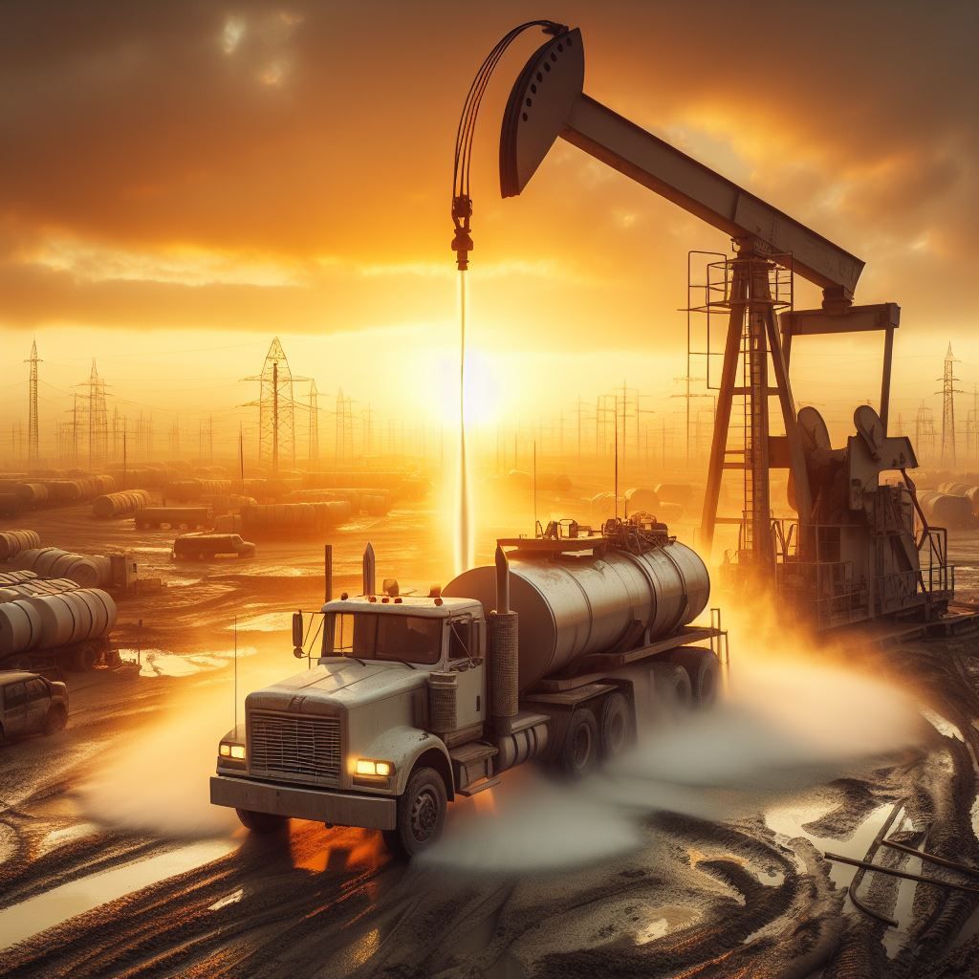
Problem Statement
Acidizing stands out as a widely employed
stimulation technique
Sandstone vs Carbonate
Complex nature in carbonates
The process is still as much art as science

Slide 4
Problem Statement
Carbonate acidizing simulator
Based on physics
Handle different configurations
Fast and accurate

Slide 5
Research: Methodology
Simulator
Upscale
Data
Train

Slide 6
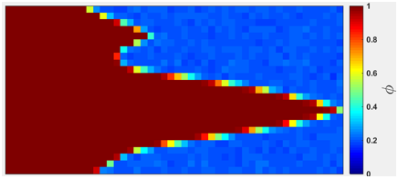
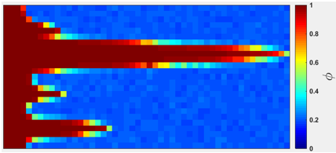
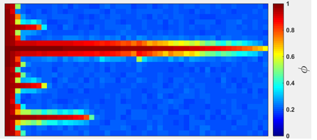
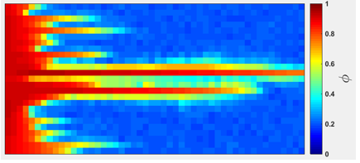
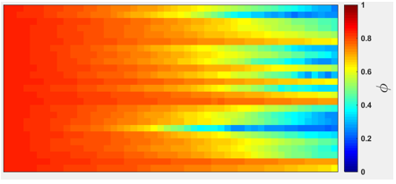
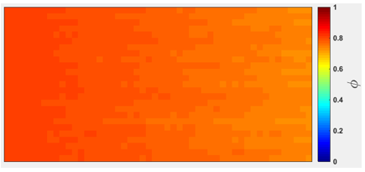
Research: Simulator

Slide 7
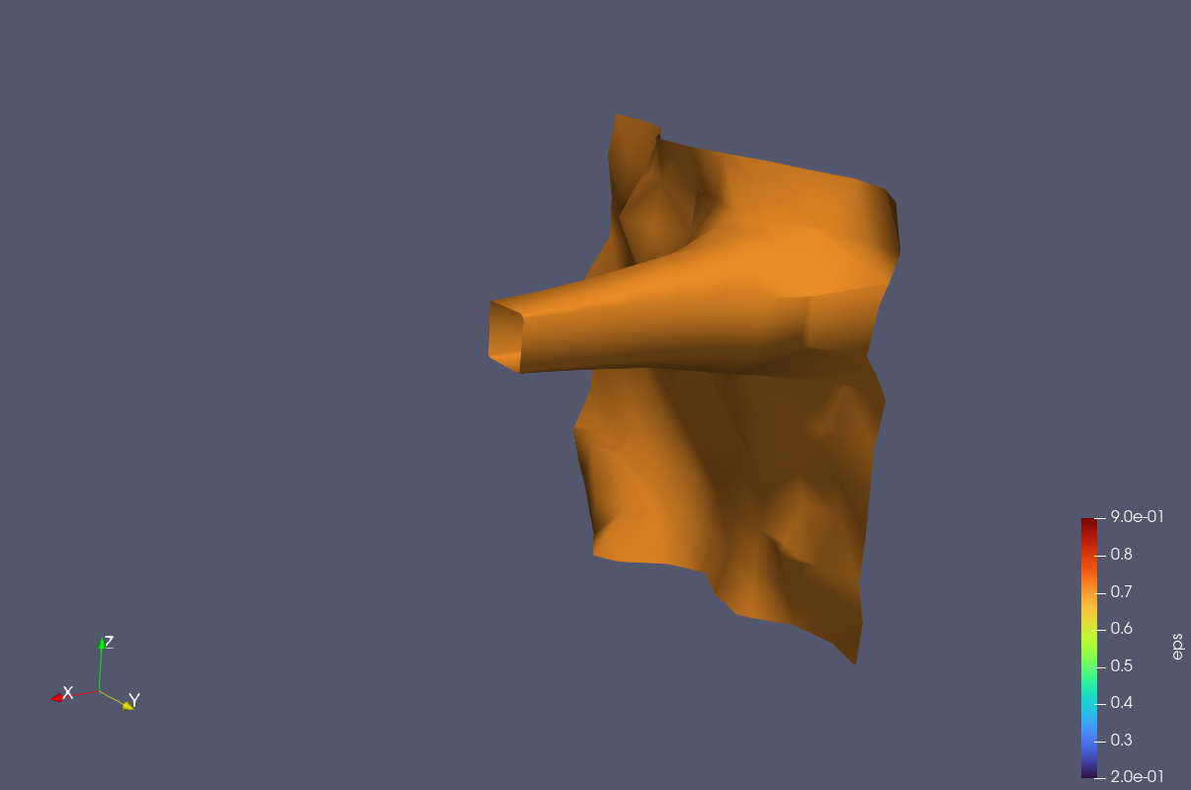
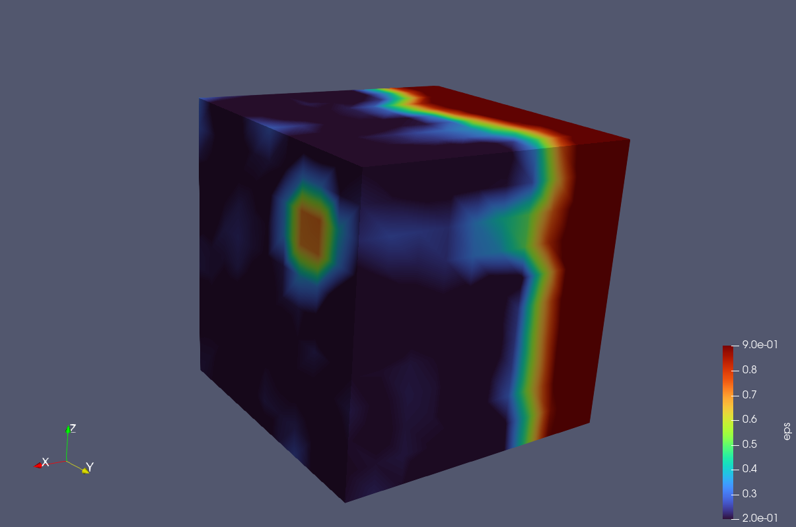
Research: Simulator

Slide 8
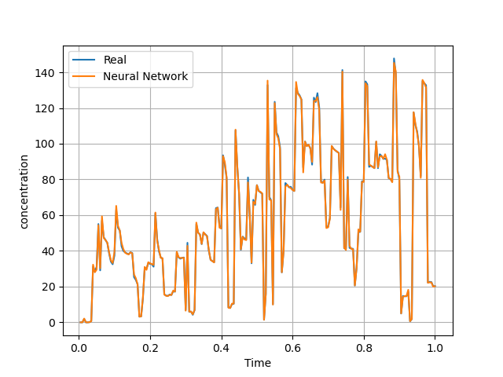
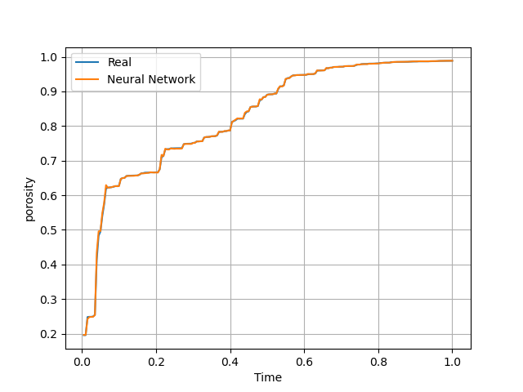
Research: Model Accuracy
Concentration
Porosity

Slide 9
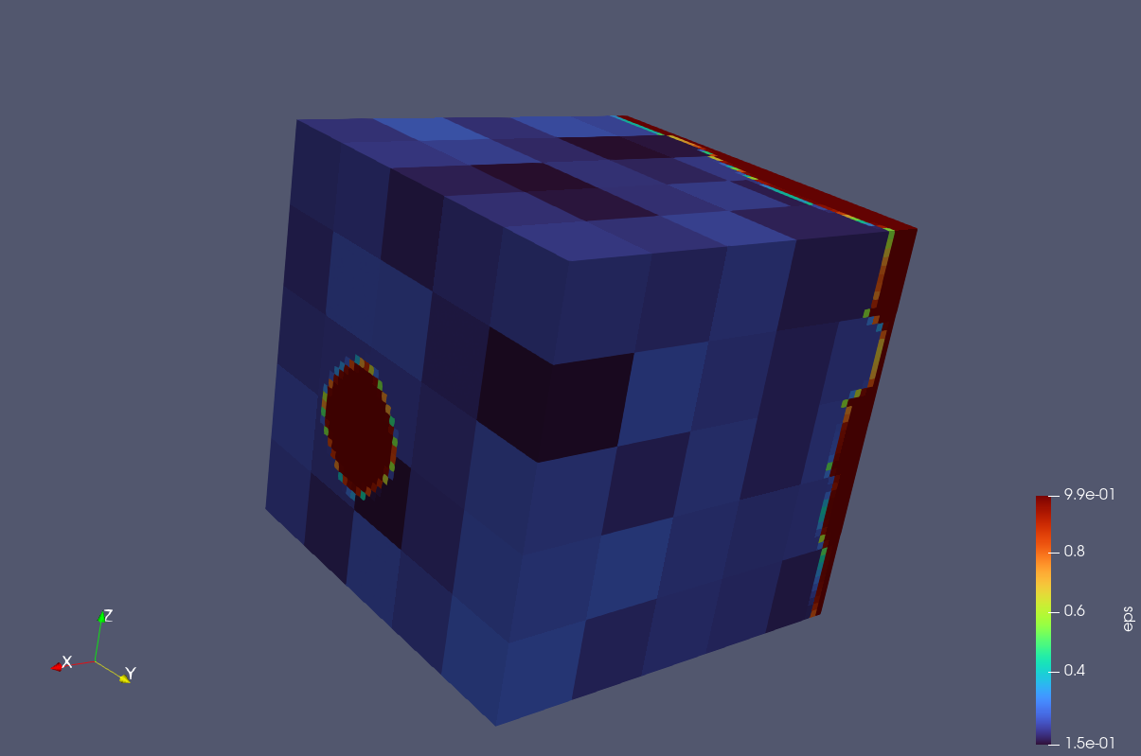
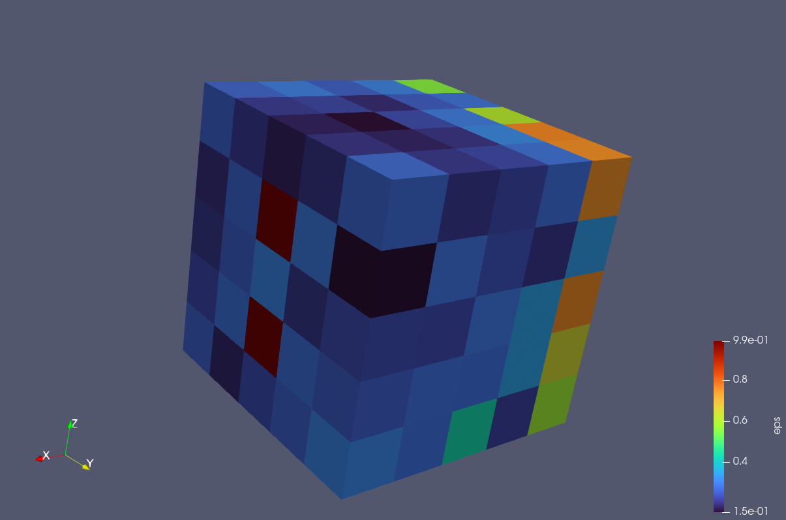
Research: Model Accuracy
CFD
Model

Slide 10
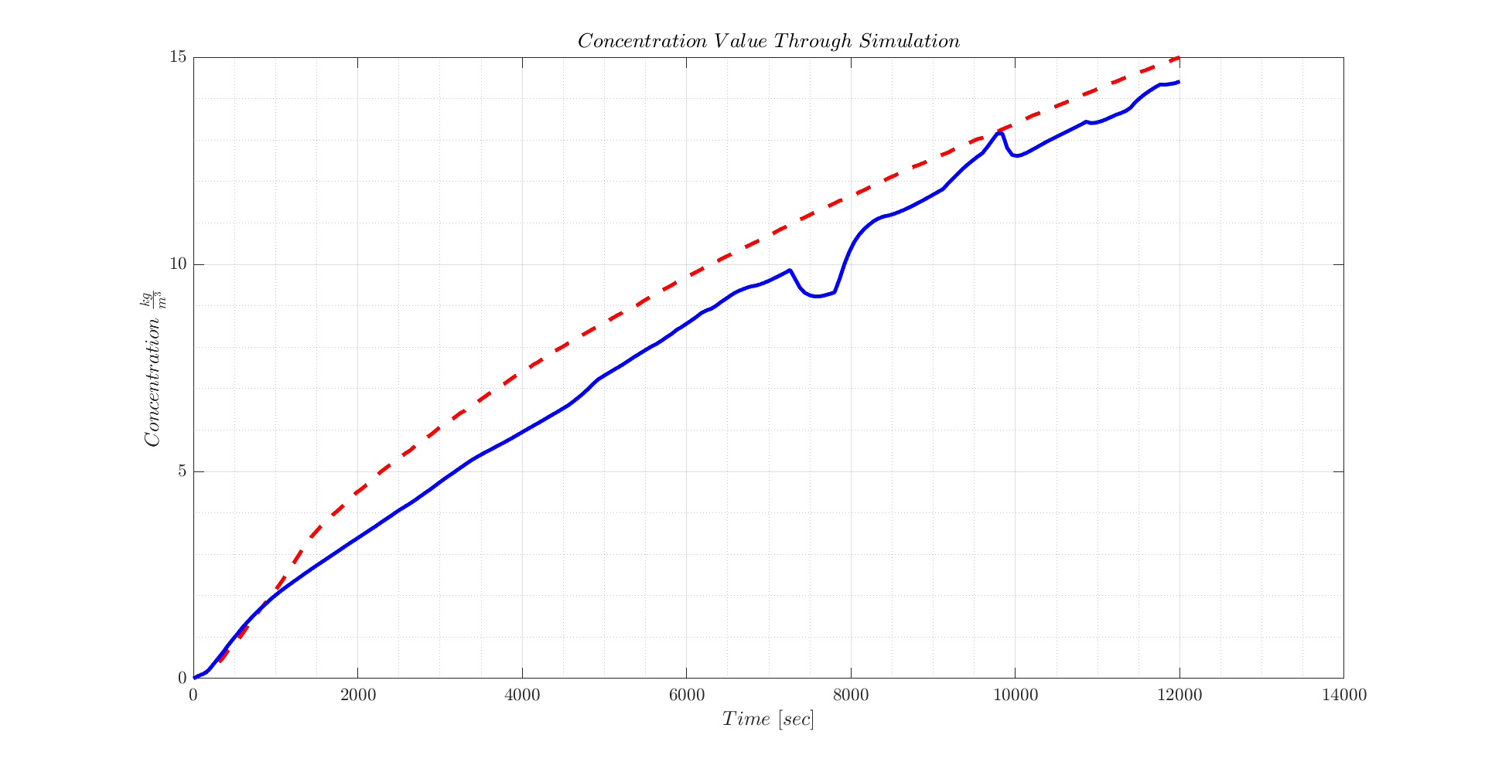
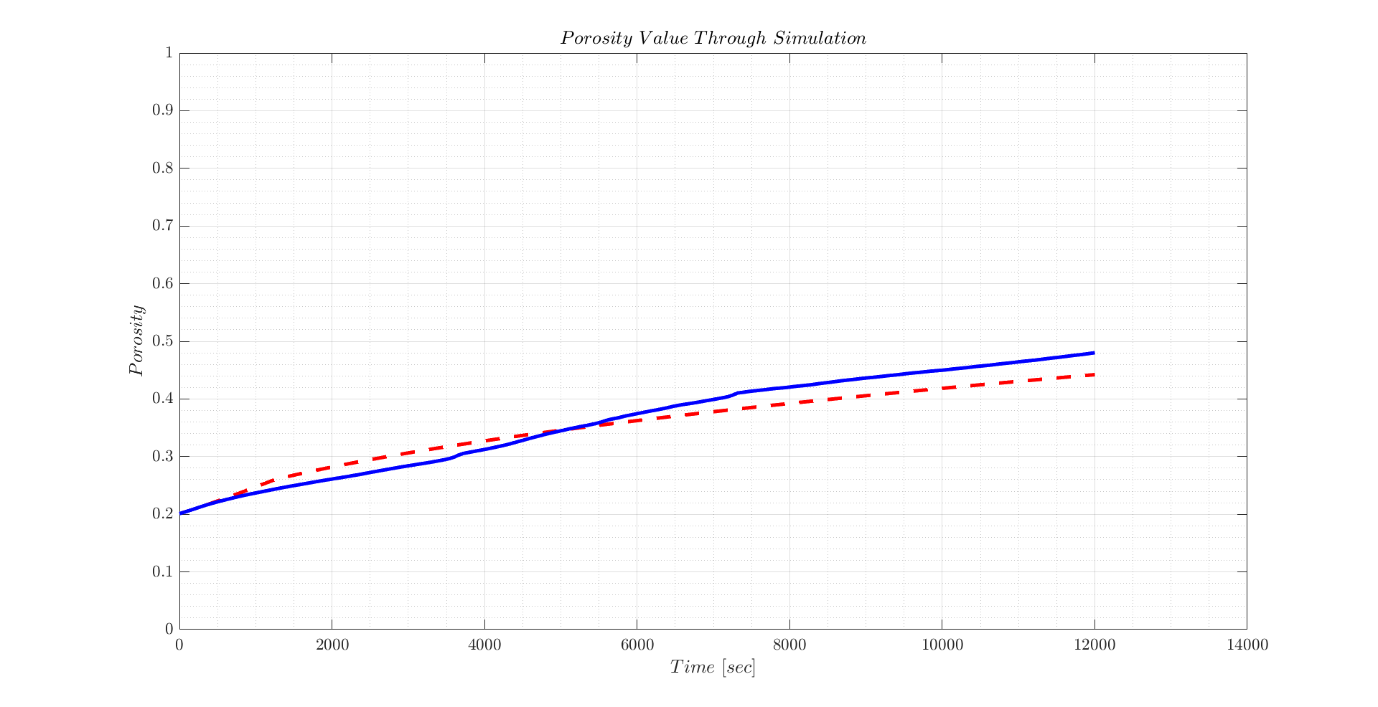
Research: Upscaling

