Slide 1


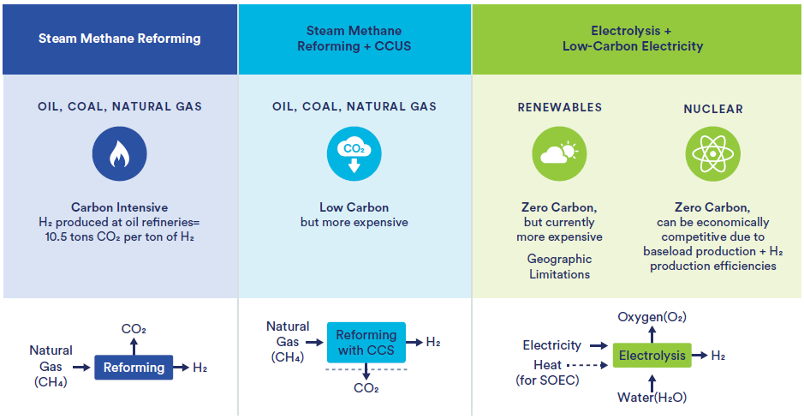
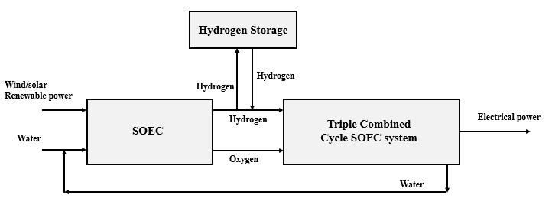
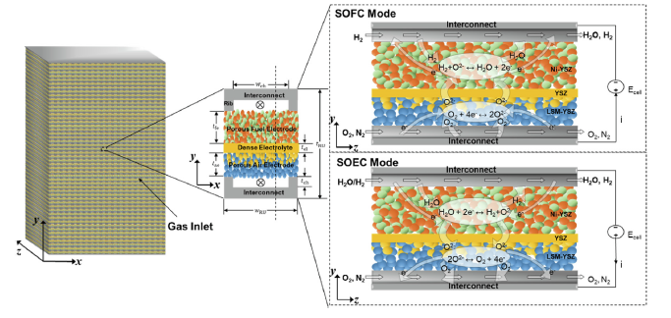
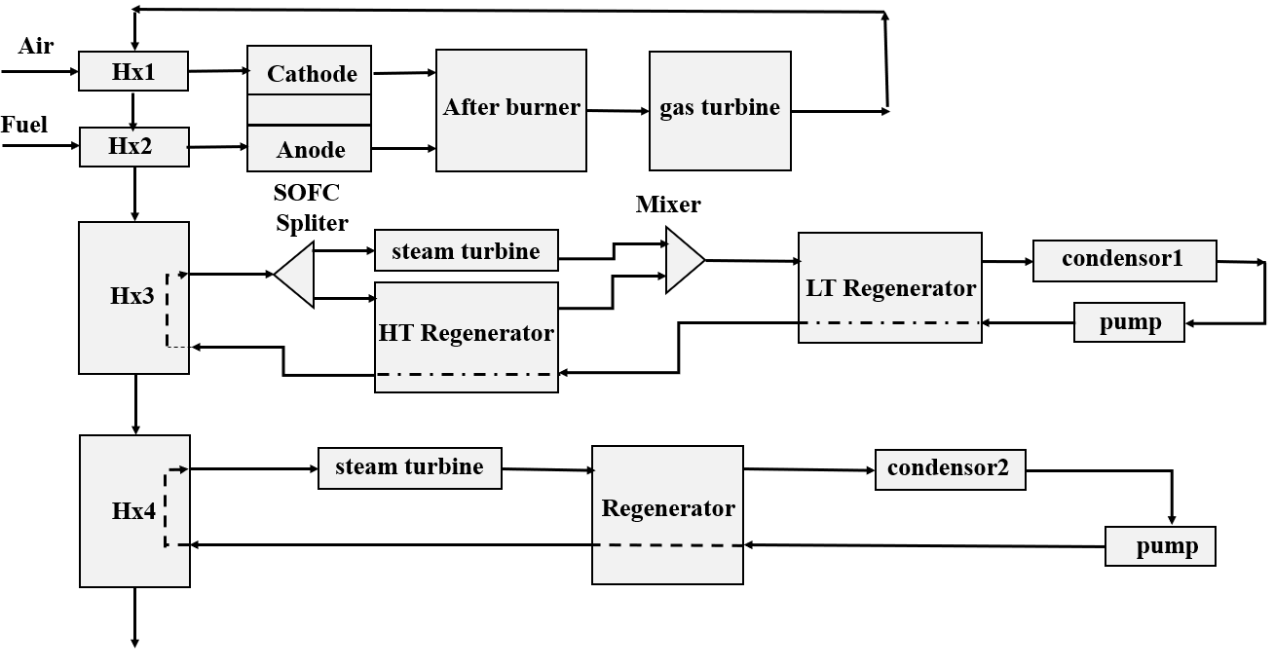
Multi-Scale Steady-State and Flexible Design and Operation of Reversible Solid Oxide Cell-Based Polygeneration Energy Systems for Microgrid Power Balancing
Seyed Jalil Montazeri
Supervisors: Dr. Davood Rashtchian , Dr. Mehdi Sharifzadeh , Dr. Sirus Ghotbi
Azar 1404
Extensive research into advanced energy systems that provide improved efficiency and operational flexibility has been prompted by the growing global energy demand as well as the urgent need to reduce greenhouse gas emissions. A viable way to address these issues is through polygeneration systems, which integrate several energy conversion and storage technologies to concurrently generate heat, electricity, and other useful products.
Introduction
The proposed polygeneration energy system produces electricity, heat, and hydrogen using renewable energy sources. During periods of low electricity demand, surplus renewable capacity is utilized to generate additional heat and hydrogen, with hydrogen being stored for later use. During peak electricity demand, the stored hydrogen is converted back into electricity using a fuel cell. This approach enables the system to respond to fluctuations in electricity demand and provides greater operational flexibility. By adjusting the combination of energy outputs, the combined generation system can contribute to balancing the performance of the microgrid.
The cogeneration of electricity and heat, the use of clean and environmentally friendly fuels, reduced dependence on fossil fuels, compatibility with renewable energy sources, uncertainty management, integration with other technologies, and environmental and economic considerations are among the key motivating factors for conducting a case study in the field of integrated and secure design and operation of multi-generation systems based on solid oxide electrolysis cells and solid oxide fuel cells.
Brief description
Hydrogen production technologies including carbon emissions
General Framework for Implementing the Optimization–Simulation Algorithm
The system configuration combines a Triple Combined Cycle Solid Oxide Fuel Cell (SOFC) system intended for high-efficiency electricity generation and hydrogen utilization with a Solid Oxide Electrolyzer Cell (SOEC) driven by renewable energy sources. Aspen Plus® was used to model the integrated polygeneration system using surrogate models created from intricate COMSOL Multiphysics® simulations.
A MATLAB-implemented hybrid genetic algorithm (GA) was used to optimize the reversible solid oxide cell (rSOC) system's design and functionality.
The optimization was carried out using a hybrid GA→fmincon approach and MATLAB's Global Optimization Toolbox. By creating and developing a population of candidate designs within predetermined constraints on structural and operational variables, the GA carries out the initial global search. The surrogate models, which swiftly and reliably calculate power prediction and feasibility across all hourly scenarios, are used to evaluate each candidate. This enables the GA to efficiently explore the high-dimensional, nonlinear landscape.
Schematic diagram of the integrated SOEC–Triple Combined Cycle SOFC system
3D schematic of a solid oxide cell
Detailed process flow diagram of the Triple Combined Cycle SOFC system
Conclusion
An integrated multi-scale framework for the design and flexible operation of a polygeneration system based on reversible solid oxide cells and meant for microgrid applications was presented in this work. The study showed how SOC-scale fidelity can be maintained while allowing for computationally efficient optimization of a complete hybrid energy system by fusing in-depth electrochemical modeling with system-level thermodynamic analysis.
References
Sharifzadeh, Mahdi, and Nina F. Thornhill. "Optimal selection of control structure using a steady-state inversely controlled process model." Computers & chemical engineering 38 (2012): 126-138.‏
Flis, G., & Wakim, G. (2023). Solid Oxide Electrolysis: A Technology Status Assessment.. https://www.catf.us/wp-content/uploads/2023/11/Solid-Oxide-Electrolysis-Technology-Status-Assessment.pdf

