Slide 1

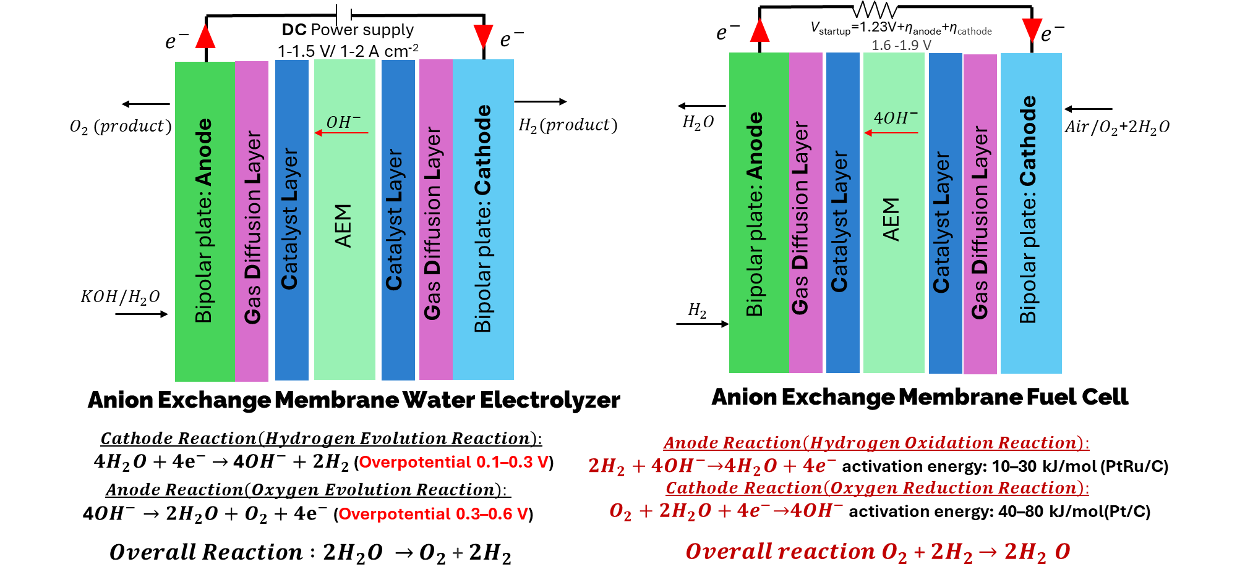
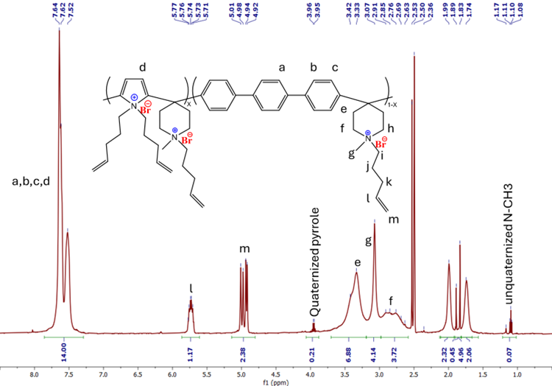
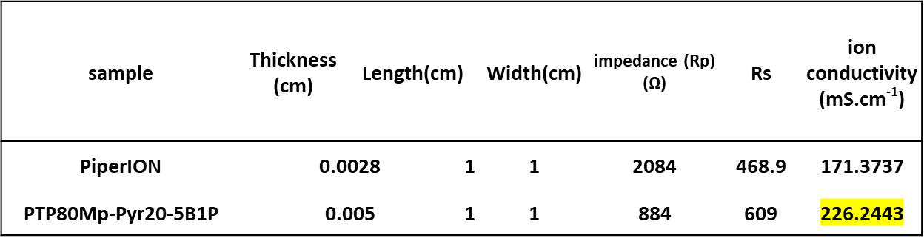
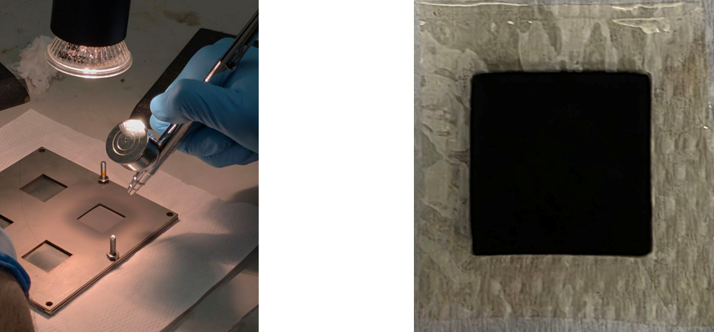
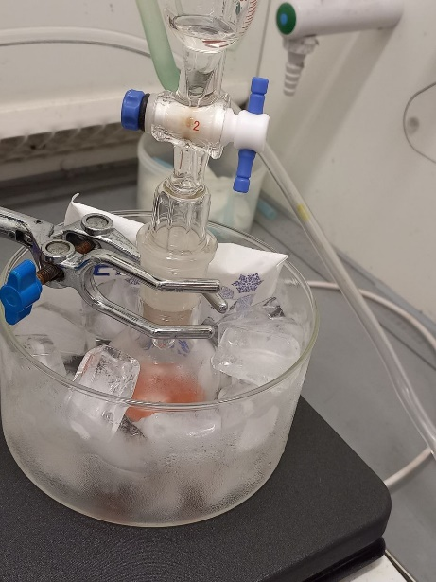
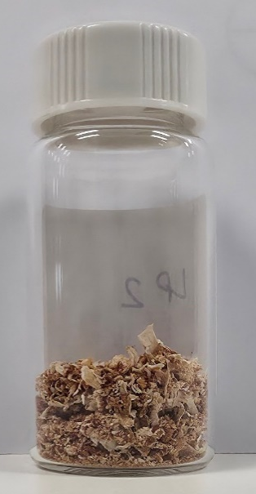
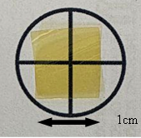
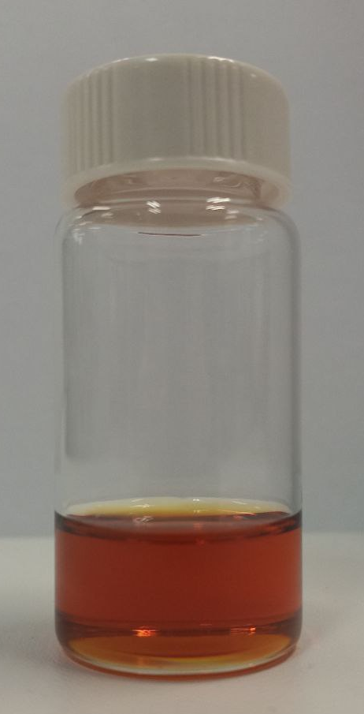
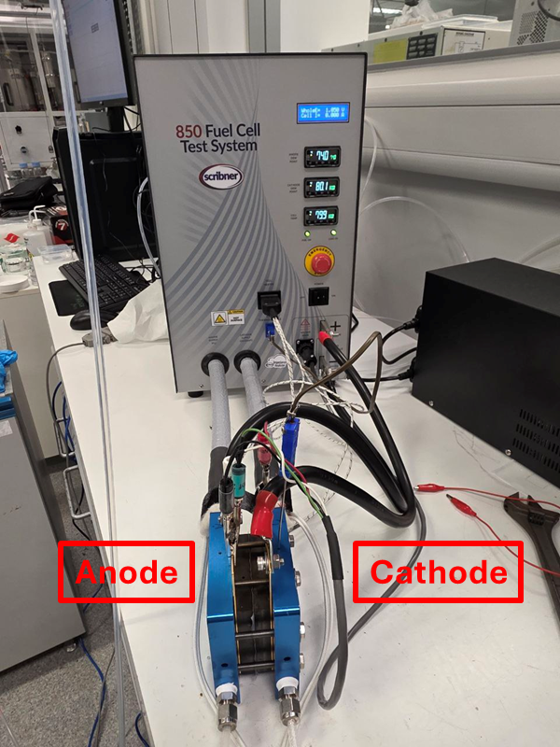
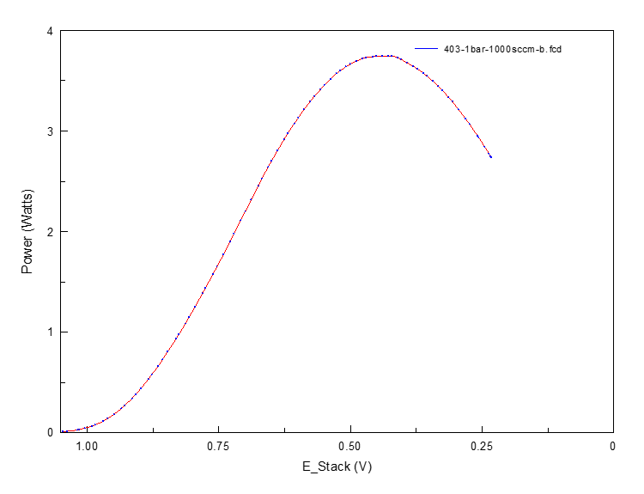
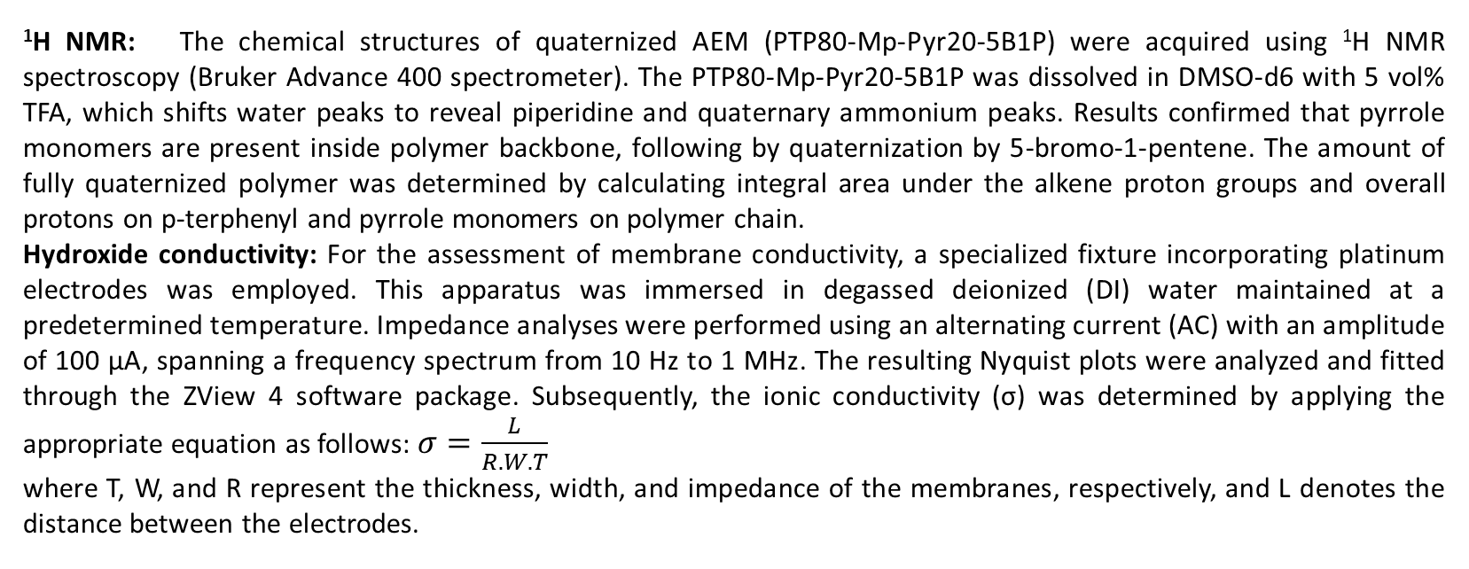
دانشکده مهندسی شیمی و نفت
دانشگاه صنعتی شریف
هفته پژوهش سال 1404
Preparation and Characterization of Ether-Free and Durable Anion Exchange Membrane for Alkaline Fuel Cell and Electrolyzer
Hamed GHAEDRAHMATI
Supervisors: Ahmad RAMAZANI S.A¹, Minhua SHAO²
Department of Chemical and Petroleum Engineering, Sharif University of Technology, Tehran, Iran
Department of Chemical and Biological Engineering, The Hong Kong University of Science and Technology, Clear Water Bay, Kowloon, Hong Kong, China
Introduction
The increasing adoption of hydrogen as a sustainable energy carrier is becoming paramount amid growing apprehensions regarding the environmental impact and finite nature of fossil fuels, which exacerbate pollution and hinder long-term ecological balance. In the evolving landscape of the hydrogen economy, numerous innovative technologies have emerged, with anion exchange membrane fuel cells (AEMFCs) emerging as a pivotal component. These systems have garnered substantial attention due to their potential as a more economical substitute for proton exchange membrane fuel cells (PEMFCs). Nevertheless, advancing high-efficiency AEMFCs demands the creation of anion exchange membranes (AEMs) that exhibit a harmonious blend of attributes, akin to those found in established Nafion membranes employed in PEMFCs. One of the foremost obstacles in this domain lies in striking an equilibrium among competing membrane characteristics
For example, augmenting the density of cationic functional groups within the membrane architecture enhances ionic conductivity, yet it often undermines the material's dimensional integrity and mechanical robustness, such as tensile strength (TS). Consequently, it is imperative to devise effective methodologies that facilitate a judicious compromise across these essential parameters, thereby fostering the evolution of superior AEMs. Such approaches must prioritize the amplification of ion conductivity and ion exchange capacity (IEC) while safeguarding structural stability and mechanical endurance. Moreover, they should ensure commendable thermal resilience and chemical durability to withstand operational rigors.
By addressing these multifaceted challenges through targeted research and material engineering, the hydrogen sector can accelerate the transition toward cleaner energy solutions. This not only mitigates reliance on non-renewable resources but also promotes broader applications in transportation, stationary power generation, and industrial processes, ultimately contributing to global sustainability goals.
Hydroxide measurements via calculated polarization resistance extracted from EIS curve indicated that PTp80Mp-Pyr80-5B1P has ion conductivity of about 226 mS.cm⁻¹, which was higher than commercial PiperION, 171 mS.cm⁻¹. This characteristic might be due to higher ion conductive spots on polymer backbone rather than PiperION.
Mechanical property: The mechanical properties of the AEMs in the Bromide form were measured using a rheometer (ARES 3, TA Instruments) at room tem­perature. Therefore, dry membranes were cut into dumbbell-shaped specimens with an effective testing area of 3.5 × 11 mm and stretched at a rate of 1 mm.min⁻¹. Results, presented in Table 2, reveals that PTp80Mp-Pyr80-5B1P has a tensile strength approximately 48 MPa, confirming mechanical stability for fuel cell test less that 2 bar back pressure.
Table1. Measured Hydroxide conductivity of PiperION and PTp80Mp-Pyr80-5B1P
Table2. Measured Mechanical properties of
PTp80Mp-Pyr80-5B1P
Figure1. Electrochemical reactions in Anion exchange membrane alkaline electrolyzer (left) and fuel cell (right)
 | PTP20Mp-Pyr80-5B1P
Tensile Strength (MPa) | 48.47±2.27
Elastic modulus (MPa) | 1813.15±113.88
Elongation @break (%) | 6.4±0.63
Figure2. ¹H NMR spectra of PTp80Mp-Pyr80-5B1P
Fuel cell performance: The evaluation of cell performance was conducted employing a single-cell fuel cell testing apparatus (Fuel Cell Technologies Inc., USA). Membrane electrode assemblies (MEAs) featuring an active surface area of 5 cm² were constructed through the catalyst-coated substrate (CCS) approach. Catalyst inks for the anode and cathode were subjected to sonication for 1 hour at 0 °C, followed by application via spray coating onto gas diffusion layers (GDLs, Toray 060) using a spray apparatus. These inks were formulated incorporating Pt-Ru/C (40 wt% Pt, 20 wt% Ru, TKK Corp.) for the anode and Pt/C (47 wt% Pt, TKK Corp.) for the cathode, combined with PiperION-A5 ionomer solution (5 wt%, I/C ratio of 0.6, Versogen, USA) dispersed in deionized water and isopropanol at a 1:12.5 ratio. Noble metal catalyst loadings were maintained at approximately 0.2 mg cm⁻² for both electrodes. Post-coating, the gas diffusion electrodes (GDEs) and anion exchange membrane (AEM) were submerged in 1 M NaOH solution for 24 hours to promote ion exchange to the hydroxide (OH⁻) form. Subsequently, the MEA was integrated into the fuel cell assembly utilizing 150 µm-thick Teflon gaskets and secured with a torque of 5.1 N-m. Testing occurred within the apparatus under conditions of 1 bar backpressure (BP), 80 °C operating temperature, and relative humidity (RH) levels of 80% at the anode and 100% at the cathode. Initial cell activation was performed at a constant voltage of 0.5 V for about 1 hour until attaining stable current density, after which polarization curves were acquired.
Material and Methods
Procedure: p-Terphenyl (921.24mg, 4 mmol), pyrrole (70 μL, 1 mmol), N-methyl-4-piperidine (676.5 μL, 5.5 mmol) and dichloromethane (3 ml) were added to 50 ml round bottom flask and stirred for 30 min (200RPM). After that, the solution was kept in ice bath and first, Trifluoracetic acid (540 μL) and then trifluoromethanesulfonic acid (3.6 ml) were added dropwise on monomer and linker solution (500 RPM). After 6-hour 5 ml dichloromethane was added to viscous solution and the diluted solution was added to 150 ml ethanol leading to precipitation of synthesized polymer. After vacuum drying at 80 °C , polymer have been crashed and washed with 1M potassium carbonate solution 24 hours, following by washing with water three times and dried in oven at 80 °C for 24 hr.
Quaternization by 5-bromo-1-pentene: PTP80-Mp-Pyr20 (0.55 gr) and potassium carbonate (400 mg ) were dissolved in 13 ml DMSO, following by adding 5B-1P (3.5 ml). Mixture was stirred at 80 °C oil bath under reflux for 24 hr (400RPM). After that, the prepared dark solution was poured into 150 ml Ethyl acetate and mixed for 15 min, following by filtration and washing with 150 ml DI water. Next, final polymer was dried in vacuum oven 80 °C for 24 hr.
Membrane preparation: PTP80-Mp-Pyr20-5B1P (0.55gr) was dissolved in 13 ml DMSO and mixed for 24 hr at RT, then filtered by 1.2 μm PTFE and casted on Petri dish in vacuum oven 75 °C for 10hr.
TFSA, TFA
1) DCM, ice bath, 9 hr, RT
2) K₂CO₃ 1 M washing 12 hr
Figure3. Catalyst Coating Membrane using Pt/C-ionomer ink on both side
of PTp80Mp-Pyr80-5B1P in hydroxide form (left) final AEM CCM before fuel cell test assembly (5cm²)
24 hr, RT, K₂CO₃
Step 1 polymerization
Step2 : Quaternization
The PTp80Mp-Pyr80-5B1P membrane achieved a peak power density (PPD) of 749.5 mW cm^{–2} at a current density of 1.7 A cm^{–2} as following figure. Higher performance might be achieved by water management via humidity control on anode and cathode side. Optimizing hydroxide conductivity via fully exchange AEM in alkaline solution and optimizing catalyst activation will improve peak power density.
3) Washed Ethyl acetate (150ml), Water (150ml)
749.5 mW/cm²
Step4 : Membrane
(28 μm thickness)
Step3 : polymer/DMSO
(4.5% w/w)
Results and Discussion
¹H NMR: The chemical structures of quaternized AEM (PTP80-Mp-Pyr20-5B1P) were acquired using ¹H NMR spectroscopy (Bruker Advance 400 spectrometer). The PTP80-Mp-Pyr20-5B1P was dissolved in DMSO-d6 with 5 vol% TFA, which shifts water peaks to reveal piperidine and quaternary ammonium peaks. Results confirmed that pyrrole monomers are present inside polymer backbone, following by quaternization by 5-bromo-1-pentene. The amount of fully quaternized polymer was determined by calculating integral area under the alkene proton groups and overall protons on p-terphenyl and pyrrole monomers on polymer chain.
Hydroxide conductivity: For the assessment of membrane conductivity, a specialized fixture incorporating platinum electrodes was employed. This apparatus was immersed in degassed deionized (DI) water maintained at a predetermined temperature. Impedance analyses were performed using an alternating current (AC) with an amplitude of 100 µA, spanning a frequency spectrum from 10 Hz to 1 MHz. The resulting Nyquist plots were analyzed and fitted through the ZView 4 software package. Subsequently, the ionic conductivity (σ) was determined by applying the appropriate equation as follows: $σ=\frac{L}{R.W.T}$
where T, W, and R represent the thickness, width, and impedance of the membranes, respectively, and L denotes the distance between the elec­trodes.
Figure4. Membrane Electrode assembly (left) and peak power density of PTp80Mp-Pyr80-5B1P (right)
REFERENCES
[1] C. Wei, W. Yu, L. Wu, X. Ge, T. Xu, Physically and Chemically Stable Anion Exchange Membranes with Hydrogen-Bond Induced Ion Conducting Channels, Polymers 14 (22) (2022), https://doi.org/10.3390/polym14224920
[2] X. Su, S. Nan, Y. Gu, W. Wei, R. He, Diphenylanthracene-based ion exchange membranes with high conductivity and robust chemical stability for acid-alkaline amphoteric water electrolysis, Chem. Eng. J. 482 (2024), https://doi.org/10.1016/ j.cej.2024.149056
[3] W. Li, R. Zhang, X. Zhao, Z. Yue, H. Qian, H. Yang, Highly proton conductive and stable sulfonated poly(arylene-alkane) for fuel cells with performance over 2.46 W cm− 2, J. Mater. Chem. A 11(9) (2023) 4547-4558. https://doi.org/10.1039/d2ta08911d

